Slide 1
Generative Bio-entity Linking Via KB guided Pre-training and syn aware fine tuning – maY , 2022
Paper presentation

Slide 2
Intro / Abstract
Challenge : No large scale human labelled data for bio EL dataset for pretraining.
(Related work )Synonym knowledge can be fed in similarity based methods, but the memory
Footprint to store representation of each concept was very large and hard to deploy.
Zero shot problem is very common.
BioMed has multiple synonyms. 1 to 1 mapping btw mention and concept hurts performance.

Slide 3
Idea in short
Idea : To generate synthetic samples with synonyms using KB. This fills the gap of pretraining corpus.
Fine tuning : Using textual similarity between mentions and synonym to get the most similar synonym to mention at decoder side.
Constraint – Expensive pretraining.

Slide 4
GENRE model
The GENRE (Generative ENtity Retrieval/linking) system as presented in Autoregressive Entity Retrieval . It is based on fine-tuned BART architecture.
Entity linking as a seq2seq task which input mention with context and outputs concept names token by token.
GENRE pretrained on Wikipedia EL data to boost performance.
GENRE performs retrieval generating the unique entity name conditioned on the input text using constrained beam search to only generate valid identifiers

Slide 5
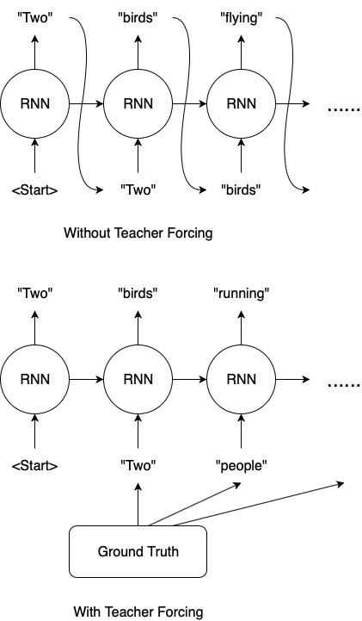
Teacher forcing at decoder side
Teacher forcing: During training decoder receives the correct output from the training set as the previously decoded result to predict the next output. However, during inference(prediction) decoder receives the previously decoded result to predict the next output. Teacher forcing improves the training process.

Slide 6
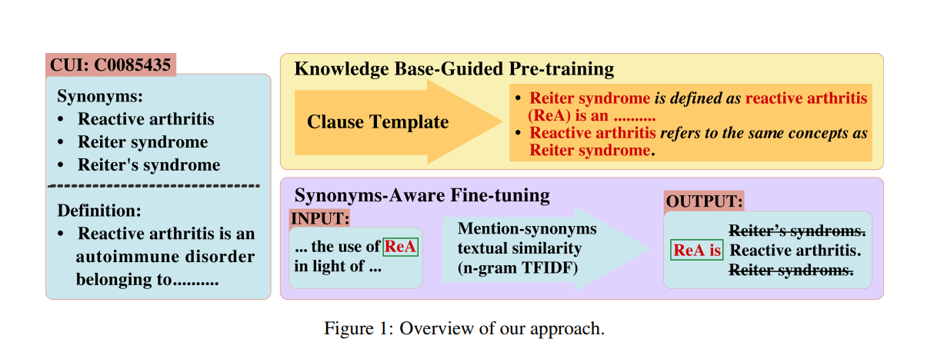
Approach

Slide 7
GENRE for our task
Used the GENRE model with some changes.
Need for change : No large scale human labelled BioMed data for EL which can be used for pretraining.
Biomed concepts contains multiple synonyms. Results are sensitive to synonyms selection for training.
This has same Format as a seq2seq Entity linking !

Slide 8

Concept – synonym mapping
For each concept “e” , we have a set of synonyms names S_e.
All the synonyms forms a name set S .(The Target names)
Names-to-concept mappings can be defined by :
For mention “m” with left and right contexts “cl” and “cr” with gold label (concept) is Em , we need to find the target concept Em_hat.

Slide 9

Seq2seq EL
The encoder input is: [BOS]cl [ST] m [ET] cr [EOS]; where [ST] and [ET] are the special tokens marking m1
For the decoder side, we use simple prefix prompts Pm = <m is> ____
This strengthens the interaction between mentions and make decoder side
output resemble natural language sentence.
[BOS] m is s; where s is a target name belong to label concept e .
Training Obj : To maximize the likelihood :

Slide 10
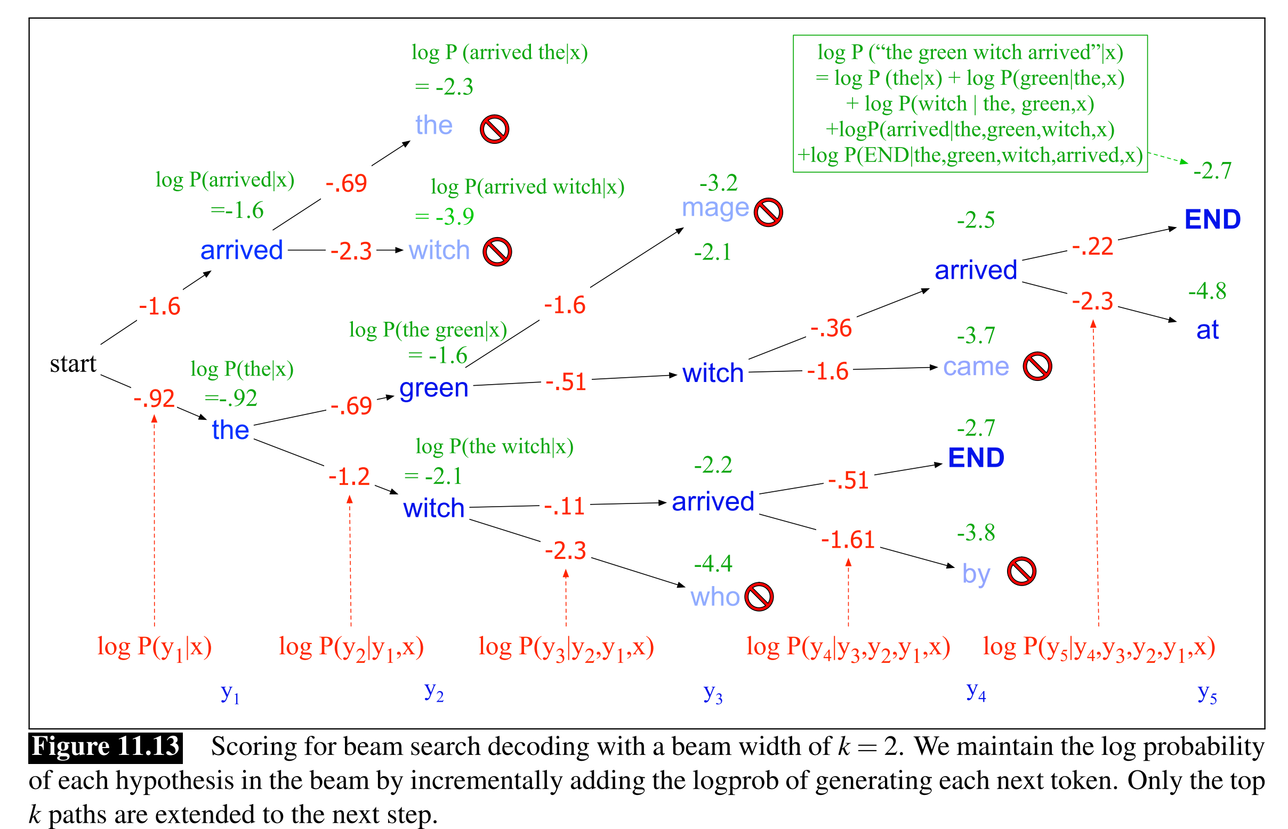
Beam search
Inference of seq2seq EL uses beam search where the target words are from the name set “S” which is set of all the synonyms mapped to all the concepts.
Beam search uses K best tokens at each step instead of only the highest probability token to find the global optimum output from all possible paths.
Negative log probability is used to get the k
best paths.

Slide 11
BarT
BART is a transformer encoder-decoder (seq2seq) model with a bidirectional (BERT-like) encoder and an autoregressive (GPT-like) decoder
We pre-train and fine-tune our model using teacher forcing and label smoothing which are standard in seq2seq training.

Slide 12
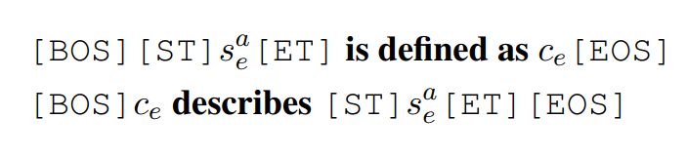
Kb Guided Pretraining
Done because of low training data compared to a large KB , which causes zero shot problem.
For this we define a set of templates , to mix synonyms and definitions and form synthetic input language.
We select 2 synonyms : Sa, Sb and definition “Ce” and concatenate them to a random template . This forms the encoder input. Ex :

Slide 13

Kb Guided Pretraining
For decoder ,
Ce is simulated context , Sb is for the model to predict.
If a definition is absent , other synonyms are used to create context.

Slide 14
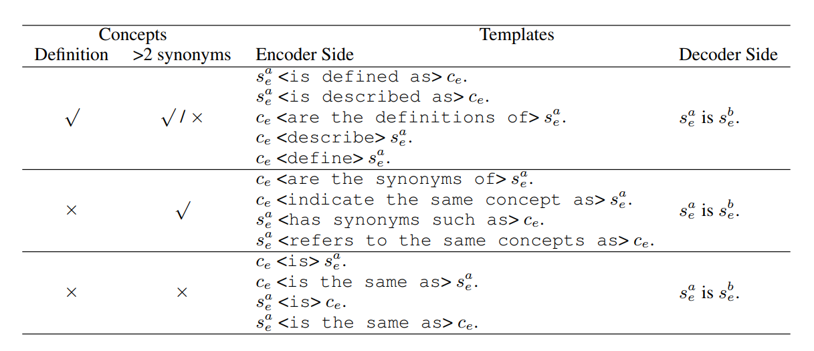
Some templates

Slide 15
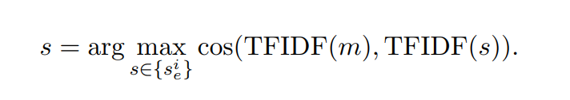
Synonym Aware fine tune
Seq2seq EL is highly influenced by textual similarity between mention and concept names.
From the synonym names generated , we select the one which has the highest TFIDF similarity with the mention.
From this , we get the synonym name Sm_hat , and map that to concept. (Em) .

Slide 16
OverAll flow
Generate Templates -> Feed in encoder -> prefix prompts -> Beam search to get target synonym tokens -> Tfidf Similarity btw mention m and all synonyms -> target synonym -> -> Get the concept for that synonym.

Slide 17
Data Used for pretraining
We use a subset of UMLS-st21pv : It contains 2.37M concepts , 1.11M concepts have multiple synonyms. 160k concepts contain definitions.
Domain : Literature .
Entity : Virus, bacterium, anatomical structure, body system, body substance, finding, injury or poisoning, biologic function, etc
From this data we generate the input to encoder.
Name set S of synonyms is also generated from UMLS.

Slide 18
Data Used for evaluation
NCBI – Domain – Literature , Entity Type – Disease , fully annotated at the mention and concept level. 6,892 disease mentions, 790 unique disease concepts.
BC5CDR – Literature , Entity Types - Chemicals, diseases, chemical-disease interaction.
4409(Chemicals) 5818(Diseases) 3116(Chemical-disease interaction).
Cometa – Layman/Social Media , Mentions – 20015. Entity types : Clinical finding (44.4%), Substance(23%) , Body Structure(11%) , procedure(7.8%) , bio products(3.6%) , physical object(3.4%),qualifier value(3%), observable entity (2%), other(10%)
Ask A Patient – Laymann Text , Entity Type – Drugs , 8,662 phrases mapped to one of the 1,036 medical concepts from SNOMED-CT

Slide 19
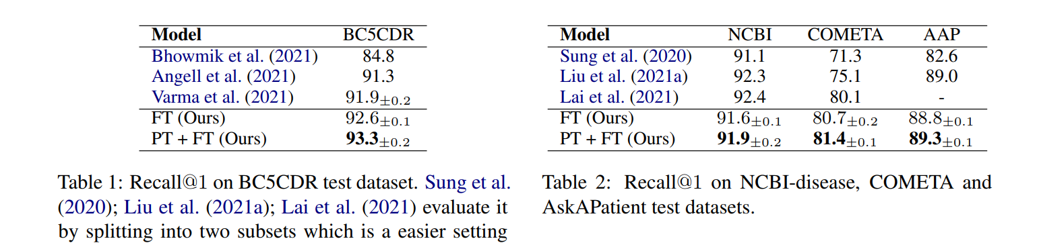
Primary Results

Slide 20
tHANK YOU !!!

